Slide 1
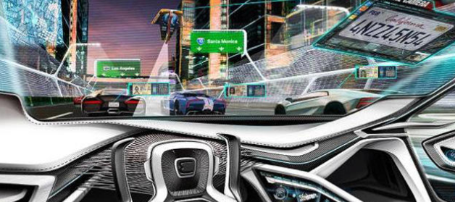
Autonomous Highway Driving using Deep Reinforcement Learning
Gal Inbar - 302569496
Eliav Shalelashvili - 318466513
Shay Dondik - 316607902

Slide 2
IN DEPTH double deep Q learning
01
Main Features – “need for safety”
02
Algorithm in high level
Safe and adaptive decision making
TABLE OF CONTENTS
04
03
Simulation and Results
05
Next Steps
06
Here you could describe the topic of the section
Here you could describe the topic of the section
Here you could describe the topic of the section
Here you could describe the topic of the section
Here you could describe the topic of the section
Here you could describe the topic of the section

Slide 3
01
IN DEPTH double deep Q learning
You can enter here the subtitle if you need it

Slide 4

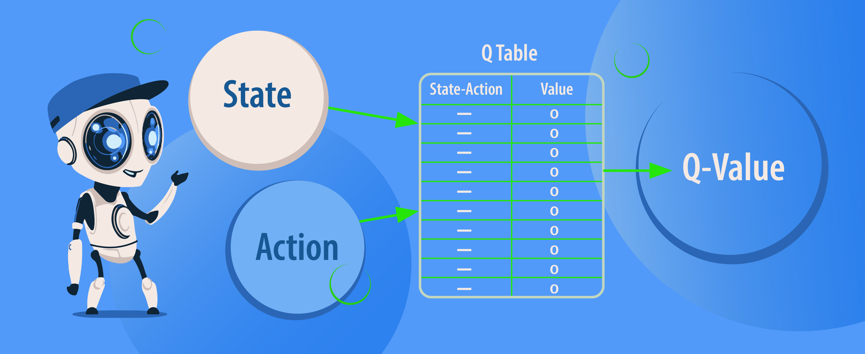
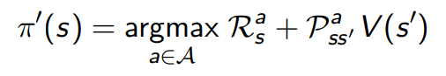
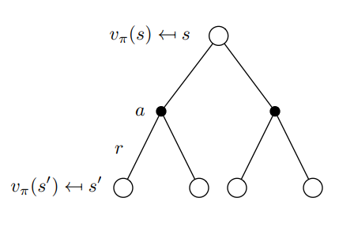
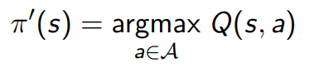
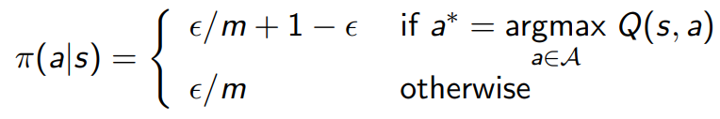
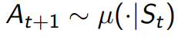
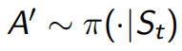
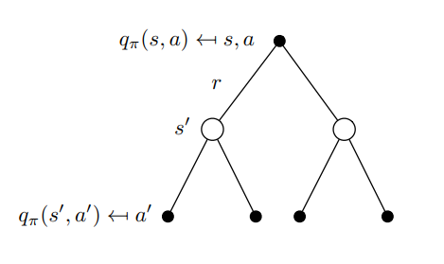
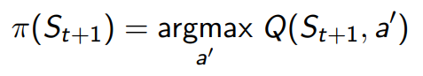
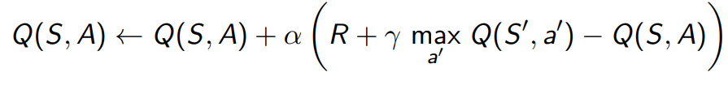
Q-Learning
Greedy policy improvement over V(s) requires model of MDP
Greedy policy improvement over Q(s, a) is model-free
Epsilon-Greedy exploration : with probability epsilon choose an action at random
Off-Policy control with Q-Learning :
Next action is chosen using behaviour policy
But we consider alternative successor action- target policy
The target policy π is greedy whereas the behaviour policy µ is epsilon-greedy
The update rule :

Slide 5
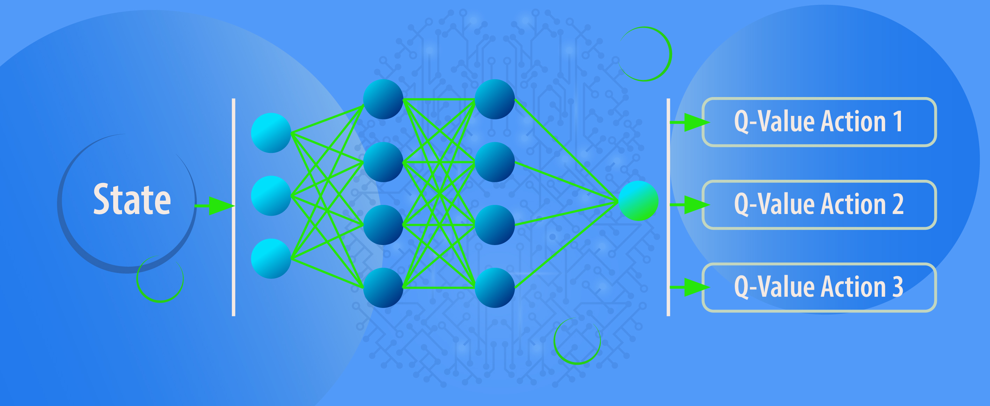
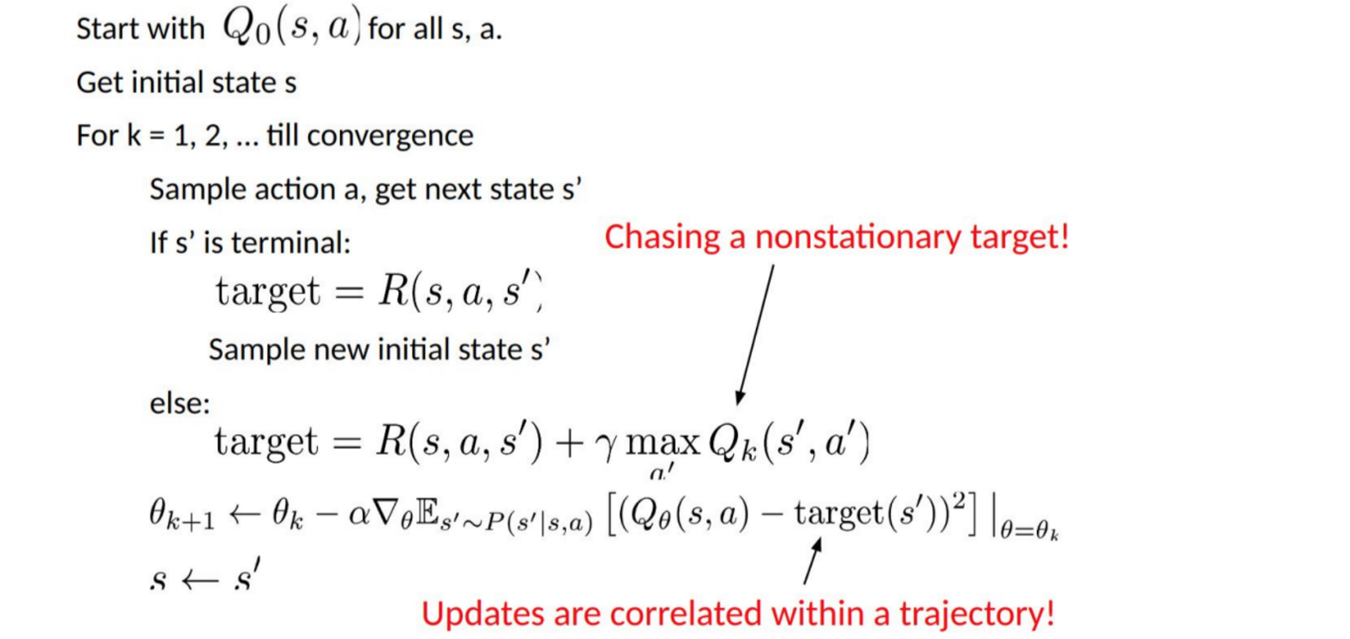

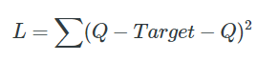
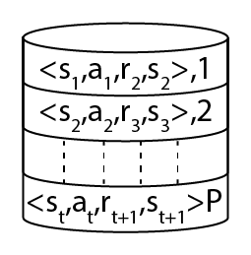
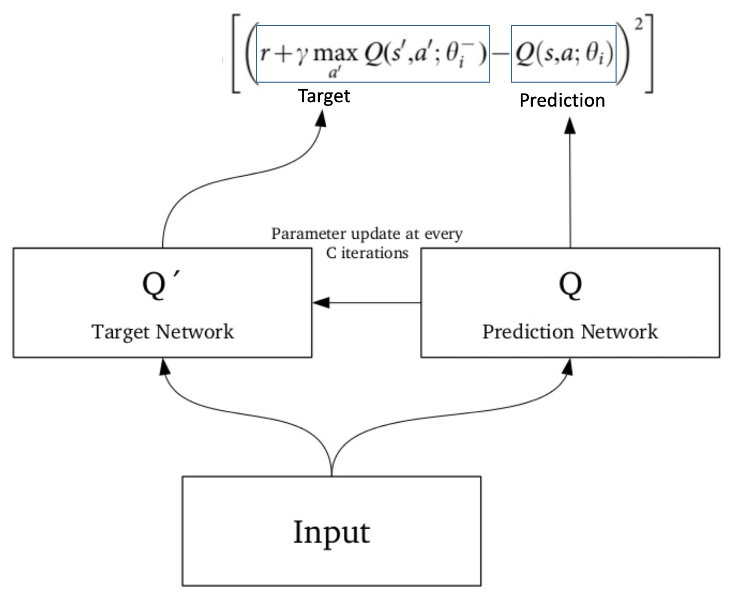
Deep Q-Learning
When the number of states and actions we can take gets more complex we use deep learning as a function approximator
We're going to calculate a loss by taking the sum of the squared differences of the Q-values and their targets
Deep Q-Learing problem: chasing a nonstationary target
Target network : we could use a separate network to estimate the target
Experience replay: the agent is now learning from a batch of experiences. From these experiences, the agent randomly selects a uniformly distributed sample from this batch and learns from that
There are a few methods to choose the next action that could be used, and a few of the most common include : epsilon greedy, epsilon soft and softmax

Slide 6

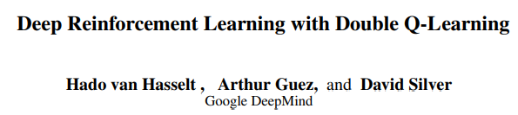
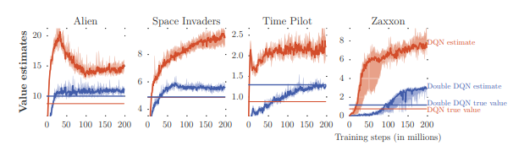
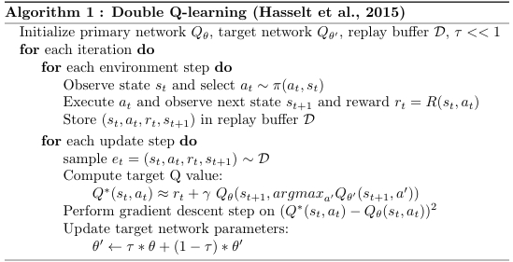

Double Deep Q-Learning
The problem of DQN : tends to prefer overestimated to underestimated values
Solution : reduce overestimations by decomposing the max operation in the target into action selection and action evaluation
In the vanilla implementation We are using the Target-Network to select the action and at the same time to estimate the quality of the action
In Double Q-Learning the TD-Target looks as follows:
While the Target-Network with parameters θ(i-1) evaluates the quality of the action, the action itself is determined by the Q-Network that has parameters θ(i)

Slide 7
02
Main Features – “need for safety”
You can enter here the subtitle if you need it

Slide 8
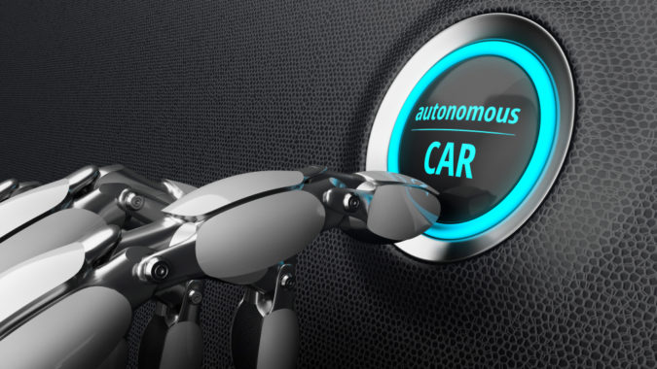
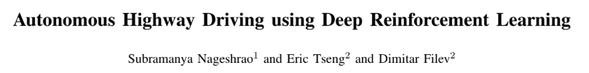
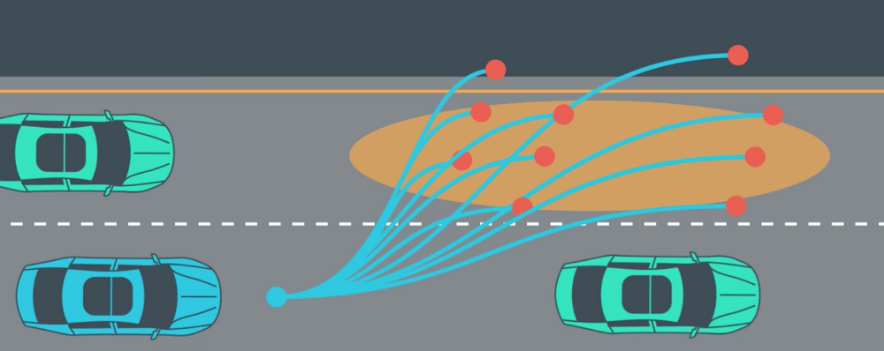
Introduction
A typical implementation of AV decision making is done by solving a number of path planning problems
They are formulated as a set of optimization problems, subject to various system and environmental constraints
In this article we introduce a Deep Reinforcement Learning (DRL) agent for highway driving
The DRL agent is designed by training an ego vehicle (EV) to learn a driving policy by directly interacting with diverse simulated traffic
The foundation of our DRL agent is a modified version of the double deep Q-network (DDQN) algorithm that was discussed in the previous slide
Path Planning

Slide 9
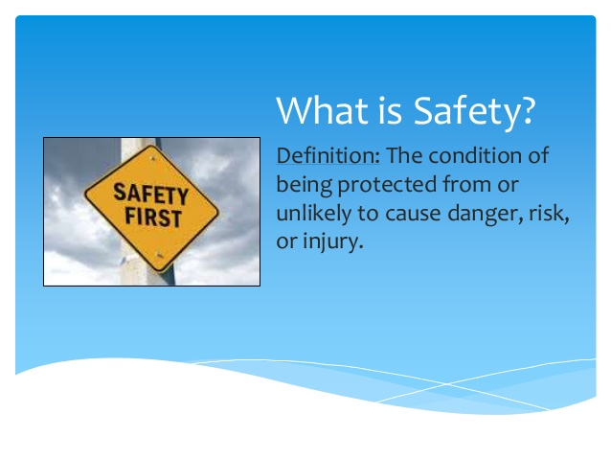
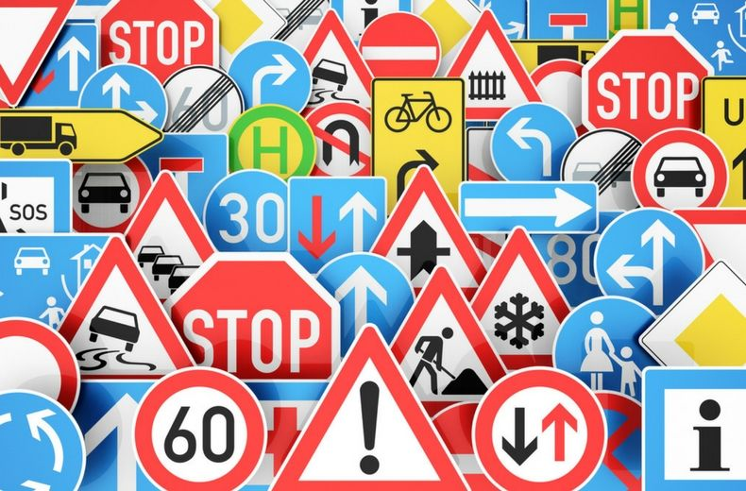
Need for safety
A key distinguishing component of RL when compared with other forms of machine learning is the trade-off between exploration and exploitation
Hence during the initial learning phase the agent will try all viable actions, unfortunately this curiosity may be fatal and can become expensive particularly when learning on a physical platform such as a robotic platform
Additionally even after convergence, due to the function approximation by the Q-network, the trained agent may chose a non-safe maneuver
Therefor we augment the DDQN decision maker with an explicit short-horizon safety check that is used both while learning and also during the implementation phase
In the RL algorithm presented in this article we use a simple safety check based on common sense road rules

Slide 10

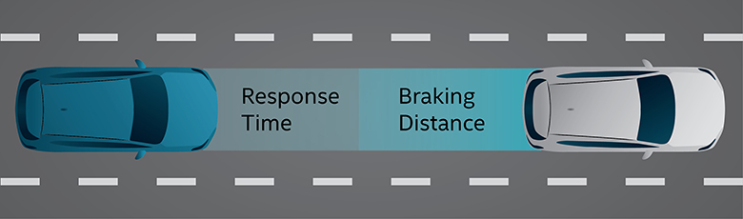
Need for safety : Part I
For training, Q-learning often relies on an exploration policy, such as epsilon greedy - arbitrary exploration without constraints could frequently lead to scenarios involving collisions, and in turn, simulation resets.
The safety check augmentation significantly improves the learning efficiency in avoiding frequent resets during training
Additionally during inference phase the safety check can be used as an override authority whenever a non-safe maneuver was chosen by the algorithm
The safety rules is based on kinematic constraints so as to minimize the collision risks or violations of some kind
Brake or break?

Slide 11

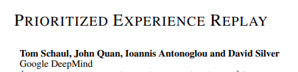
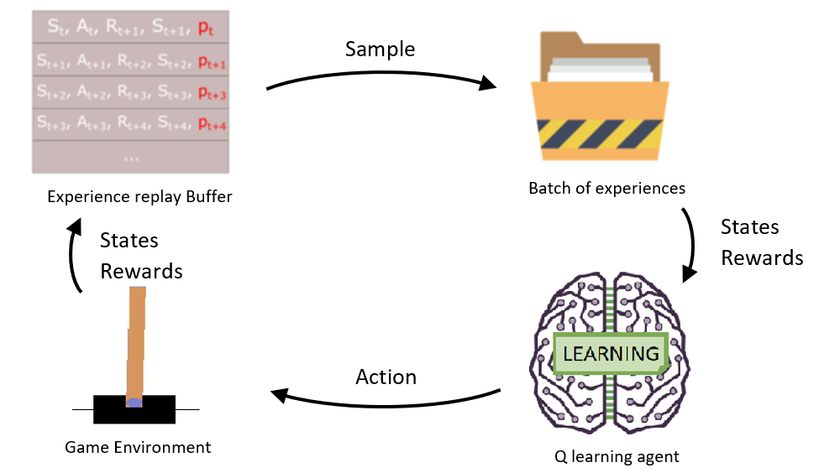
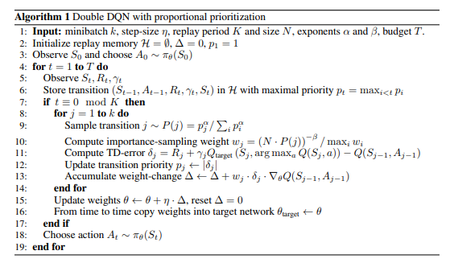
Need for safety : Part II
We keep the situations that invoke the safety violation in a collision buffer
As such, the safety check facilitates a constrained exploration during learning which enhances learning efficiency and achieves stable learning
Use of two buffers is a simpler version of prioritized experience replay as discussed earlier

Slide 12
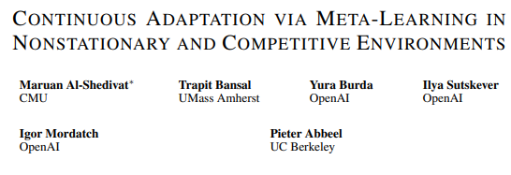
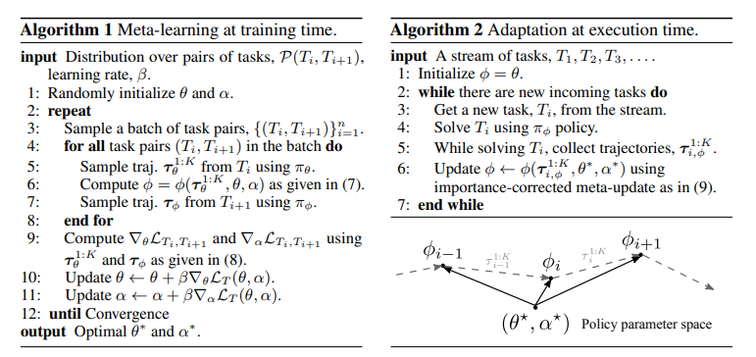
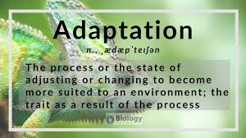
Need for safety : Part III
The inclusion of safety controller during inference phase leads to an interesting scenario, where by using new information the learned agent can be re-trained thus resulting in continuous adaptation
The new information can be potentially obtained from real-world data by deploying the initially trained agent in multiple vehicles

Slide 13
03
Safe and adaptive decision making

Slide 14

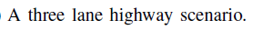
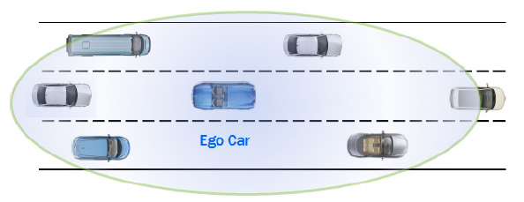
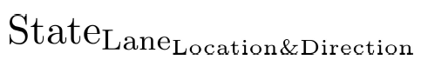
Ego car environment
Use the concept of affordance indicators. (In real life can be produce
by “LIDAR” sensors ).
3 for EGO car and 24 represent the spatial-temporal information of the six
nearest traffic vehicles, formulated from the ego vehicle’s perspective.
Traffic vehicle’s variable :
State : distance d or velocity v.
Lane : right lane rl, centre lane cl, or left lane ll.
Location : front f or rear r
Direction : longitudinal x lateral y.
Example : relative distance and velocity, in longitudinal and lateral direction, to the
closest front car in the right lane.

Slide 15
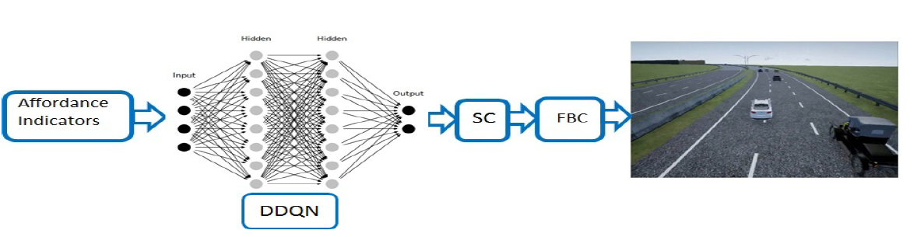
DRL agent control architecture
lateral direction
keep lane,
change lane to right, change lane to left
Inputs - 27 affordance indicators.
DDQN - as described in 01.
SC - short-horizon safety check.
FBC - low-level feedback controller.
Outputs : 12 unique action choice
longitudinal direction
maintain speed
accelerate,
brake, hard brake

Slide 16
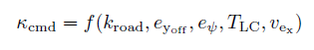
Agent Steering
One of 2 outputs: change lane to right, and change lane to left
FBC steering - The inputs to the steering
feedback controller can be considered as additional
affordance indicators which can be obtained from the perception module.
The inputs to the steering feedback controller can be obtained from the sensing module.(Lidar)
kroad is the road curvature
e = is the heading angle offset
TLC is the desired time to complete a lane change
eyoff is the lateral offset to the desired position- lane width..

Slide 17
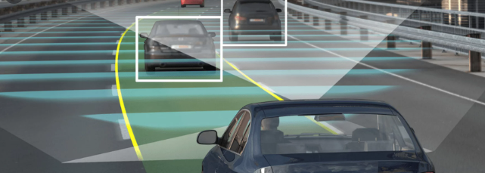
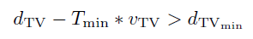
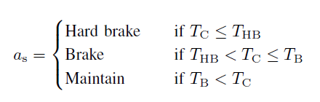
Short-horizon safety check
SC (short-horizon safety check) validate the action choice by DDQN, by the following :
dTV = relative distance
vTV = relative velocity to a traffic vehicle
Tmin = minimum time to collision.
dTVmin = minimum gap which must be ensured before executing the action choice by the DDQN.
Actions of short-horizon safety controller:
TC = calculated time to collision
THB / TB = thresholds above which the decision made.
Any new safety violation data will be added to the collision buffer BufC.
Due to function approximation there can be a small probability of choosing an unsafe action even by trained agent.
BufC enable re-training our agent on edge scenarios and lower that probability.

Slide 18
04
The Algorithm

Slide 19
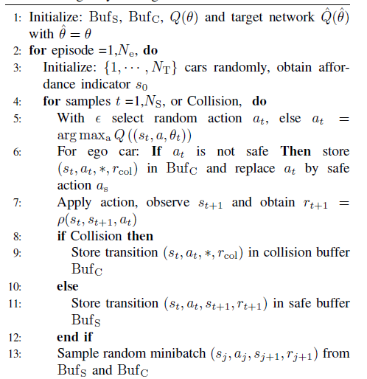
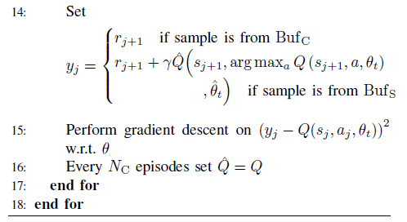
Algorithm for autonomous highway driving.
A DRL based safe decision maker for autonomous highway driving :
Q(Θ) , Q^(Θ^) – Q functions (value) under policy π to maximize the total
accumulated reward.
ε - greedy strategy to select : Exploration / Exploitation.
at – action at time t
as – safe action.
yj – reward function.

Slide 20
05
Simulation and Results

Slide 21
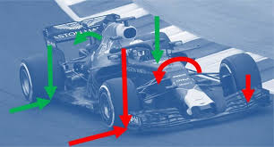
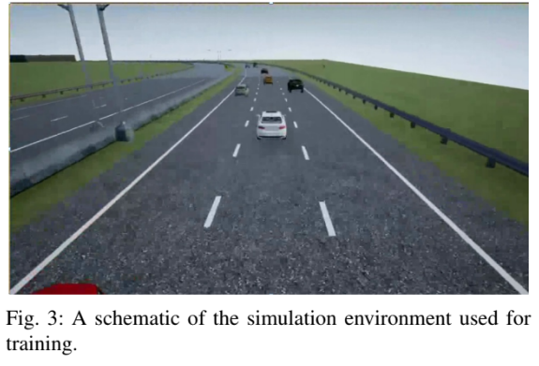
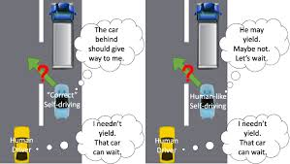
USE OF DRL FOR DECISION MAKING
In this section we will show the usability of our DRL based decision making Algorithm 1 for autonomous highway driving.
We introduce the vehicle dynamical model that was used training, following this we will elaborate on the training environment and evaluate the learned policy
Vehicle dynamics
Simulation environment
Decision making for ego vehicle
Continuous adaptation

Slide 22

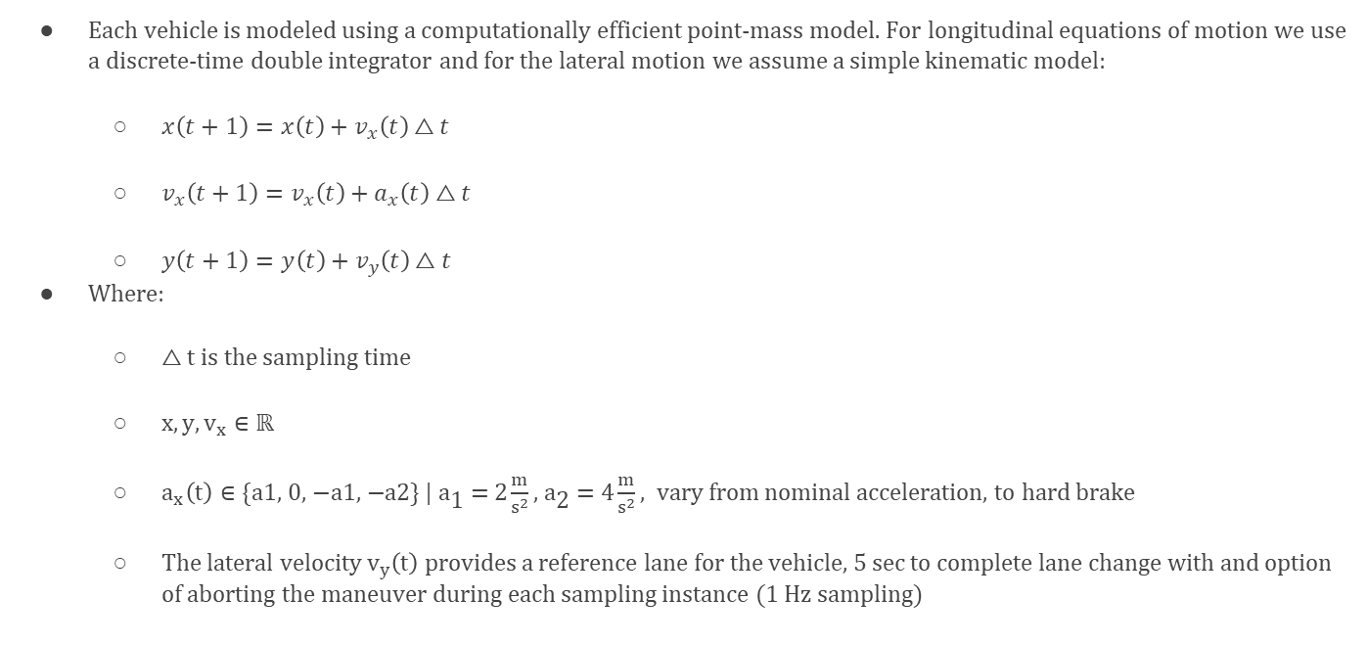
Vehicle dynamics
Each vehicle is modeled using a computationally efficient point-mass model. For longitudinal equations of motion we use a discrete-time double integrator and for the lateral motion we assume a simple kinematic model:
$x\left(t+1\right)=x\left(t\right)+v_{x}\left(t\right)△t$
$v_{x}\left(t+1\right)=v_{x}\left(t\right)+a_{x}\left(t\right)△t$
$y\left(t+1\right)=y\left(t\right)+v_{y}\left(t\right)△t$
Where:
$△t$ is the sampling time
$x,y,v_{x}∈ℝ$
$a_{x}\left(t\right)∈\text{\{}\text{a}\text{1, 0, −}\text{a}\text{1, −}\text{a}\text{2\} | }{\text{a}}_{\text{1}}\text{ = 2}\frac{m}{s^{2}}\text{, }{\text{a}}_{\text{2}}\text{ = 4}\frac{m}{s^{2}}$ , vary from nominal acceleration, to hard brake
The lateral velocity $v_{y}\left(t\right)$ provides a reference lane for the vehicle, 5 sec to complete lane change with and option of aborting the maneuver during each sampling instance (1 Hz sampling)

Slide 23
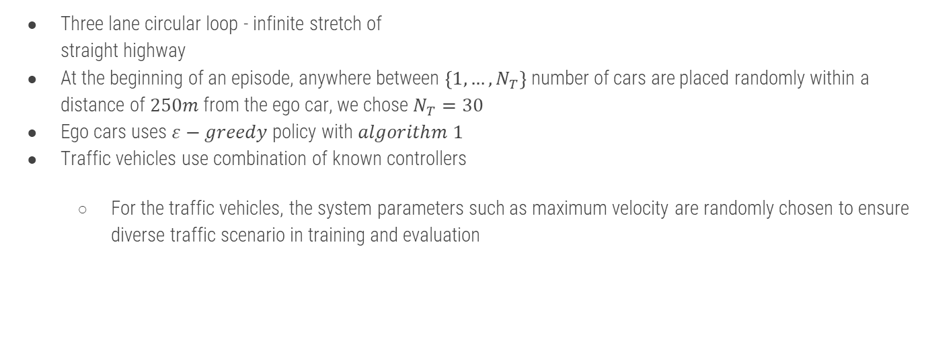
Simulation environment
Three lane circular loop - infinite stretch of straight highway
At the beginning of an episode, anywhere between $\left\{1,…,N_{T}\right\}$ number of cars are placed randomly within a distance of $250m$ from the ego car, we chose $N_{T}=30$
Ego cars uses $ε−greedy$ policy with $algorithm 1$
Traffic vehicles use combination of known controllers
For the traffic vehicles, the system parameters such as maximum velocity are randomly chosen to ensure diverse traffic scenario in training and evaluation

Slide 24
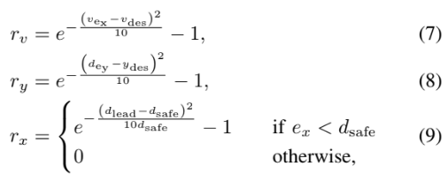
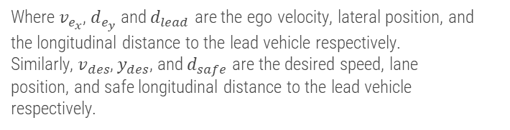

Decision making for ego vehicle
In order to train the policy $π$ we use a reward function $ρ$ that consists of a set of driving goals for the ego car. It is formulated as a function of:
Desired traveling speed subject to traffic condition (7)
Desired lane and lane offset subject to traffic condition (8)
Relative distance to the preceding car based on relative velocity (9)
Where $v_{e_{x}}$, $d_{e_{y}}$ and $d_{lead}$ are the ego velocity, lateral position, and the longitudinal distance to the lead vehicle respectively.
Similarly, $v_{des}$, $y_{des}$, and $d_{safe}$ are the desired speed, lane
position, and safe longitudinal distance to the lead vehicle
respectively.

Slide 25
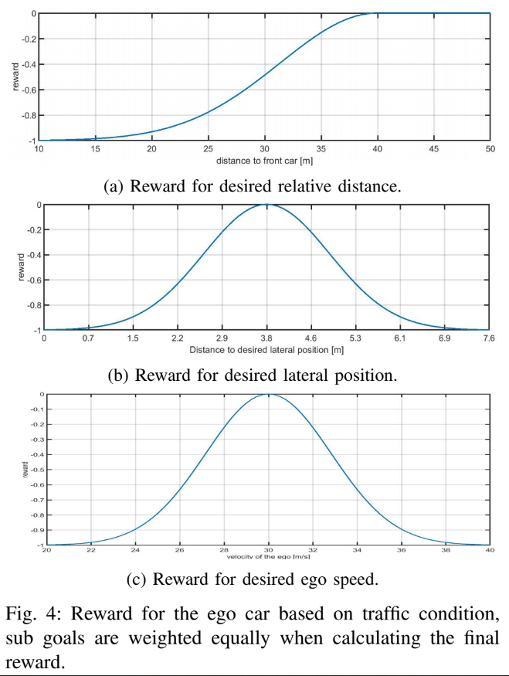



$d_{safe}=40 m$
$y_{des}=3.8 m$
$v_{des}=30 m/s$

Slide 26

Policy evaluation model
DDQN model
Parameters:
2 hidden layers, each having 100 fully connected leaky ReLU’s
Train the network using Adam optimizer with a fixed learning rate of ${10}^{−4}$
Exploration is continuously annealed from 1 to 0.2 over first 7000 episodes and then kept constant for the remaining duration of learning.
During learning we evaluate the (partially) trained DRL controller every ${100}^{th}$ episode
We train the DRL agent for a total of 10000 episodes. Where each episode lasts until 200 samples or collision, whichever is earlier

Slide 27

It takes nearly 2000 episodes for the agent to converge
For the highway driving task, the safety controller was found to be a key component for learning a meaningful policy.

Slide 28


Continues adaption
Whenever the control decision by $DDQN$ fails the short-horizon safety check
Using a lower learning rate than the one used for training, $Q−network$ can be retrained
During the implementation phase, we replace the $ε$–greedy policy, $i.e.$, $π_{ε}$ in $Algorithm 1$ (line 5) by the learned policy $π$.
Fig. 8 shows the continuous adaptation result over 30K episodes
It is obtained by averaging the data over 10k episodes
Because of filtering, the mean number of safety trigger increases over first 10k episodes and stays constant for no adaptation scenario whereas it monotonically decreases to a smaller value thanks to continuous adaptation.

Slide 29
06
Next Steps

Slide 30
What’s next?
Find a simulation framework that support development, training, and validation of autonomous driving systems
Carla
Examine the algorithms:
DDQN
DDQN with safety
Test the results over different parameters and reward functions
Increase degree of simulation
More cars, higher velocities etc.

Slide 31
Carla
simulation framework that support development, training, and validation of autonomous driving systems
Highlighted features
Flexible API
Autonomous Driving sensor suite
Fast simulation for planning and control
Maps generation
Traffic scenarios simulation
Autonomous Driving baselines

Slide 32

Video Time!

Slide 33

Reinforcement learning algorithms
DDQN
Prove convergence to some policy
DDQN + safety
Prove the usefulness of safety concept the article propose

Slide 34



SNEAK PEEK sensor.camera.rgb
sensor.camera.semantic_segmentation
The "RGB" camera acts as a regular camera capturing images from the scene.

Slide 35


IN DEPTH
Xception
SeparableConv is the modified depthwise separable convolution.
Xception outperforms VGGNet [4], ResNet [3], and Inception-v3

Slide 36




TensorBoard results
Notes:
Loss explosions at MobileNetV2 – which cause the car to rotate endlessly
Reward Max is not good at MobileNetV2, in the other hand Xception increase in healthy way
Accuracy at Mobile reach 1 - overfitting which isn’t good.

Slide 37




TensorBoard results ( 1000 episodes)
Notes:
Loss explosions at MobileNetV2 – which cause the car to rotate endlessly
Reward Max is not good at MobileNetV2, in the other hand Xception increase in healthy way
Accuracy at Mobile reach 1 - overfitting which isn’t good.

Slide 38

Future work
ConvLSTM
In our case, sequencial images, one approach is using ConvLSTM layers. It is a Recurrent layer, just like the LSTM, but internal matrix multiplications are exchanged with convolution operations. As a result, the data that flows through the ConvLSTM cells keeps the input dimension (3D in our case) instead of being just a 1D vector with features.

Slide 39
THANKS

